Slide 1

CENSUS REPORTING SYSTEM(BI Project)
BY-ADITYA GARG

Slide 2
PROBLEM STATEMENT
Objective
Development of a Census Reporting System.
Abstract of the project
A Census is the procedure of systematically acquiring and recording information about the members of a given population.
The Population Census is the most detailed information source on the population at the level of small localities and small groups in population.
PURPOSE OF THE PROJECT
The purpose of this project is to gather information about general population in order to present a full and reliable picture of population in Cities- its Demographic and housing conditions, social and economic characteristics. This project is essential for City wise comparisons of any kind of Statistics. It collects data on many attributes of population, not just for the count of people, although population estimates remain an important function of Census

Slide 3
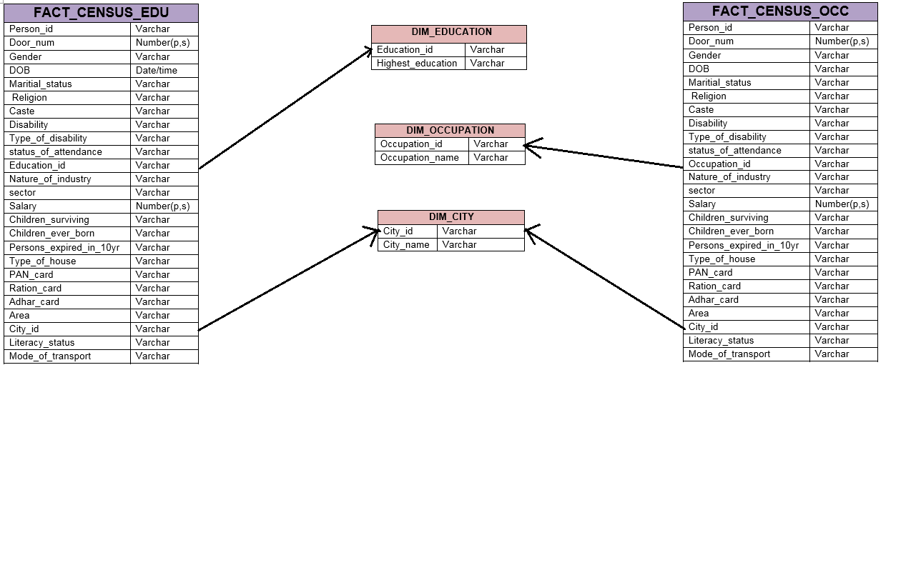
-----------SCHEMA----------

Slide 4
ABINITIO GRAPHS

Slide 5
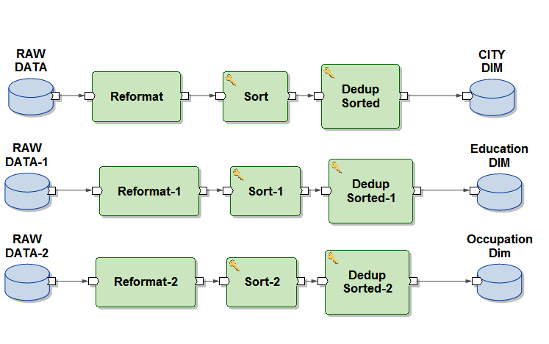
Generating Dimension Tables
City DIM having CityID, City Name.
Education DIM having EducationID, Highest Education.
Occupation DIM having OccupationID, Occupation Name.

Slide 6
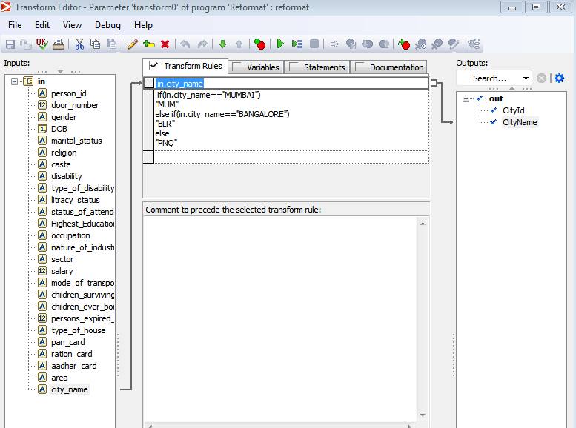
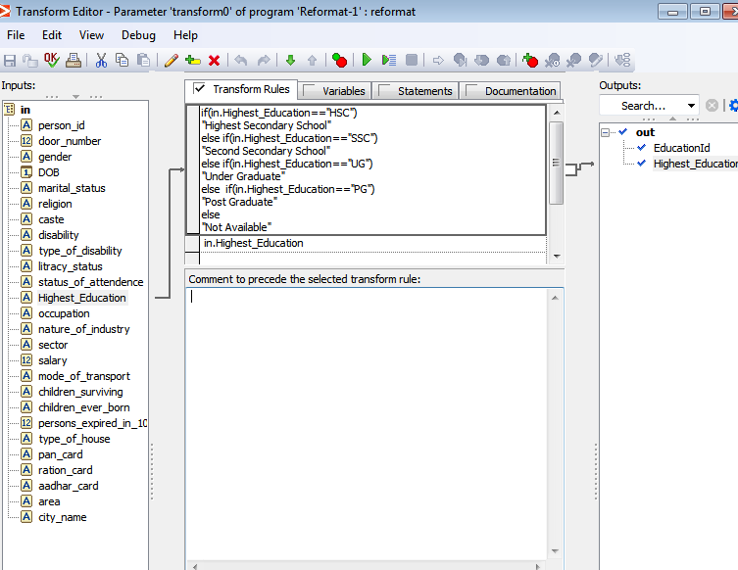
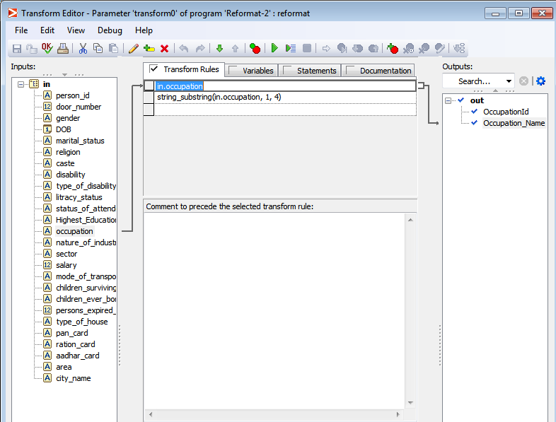
Reformat Properties for Dimension Tables

Slide 7
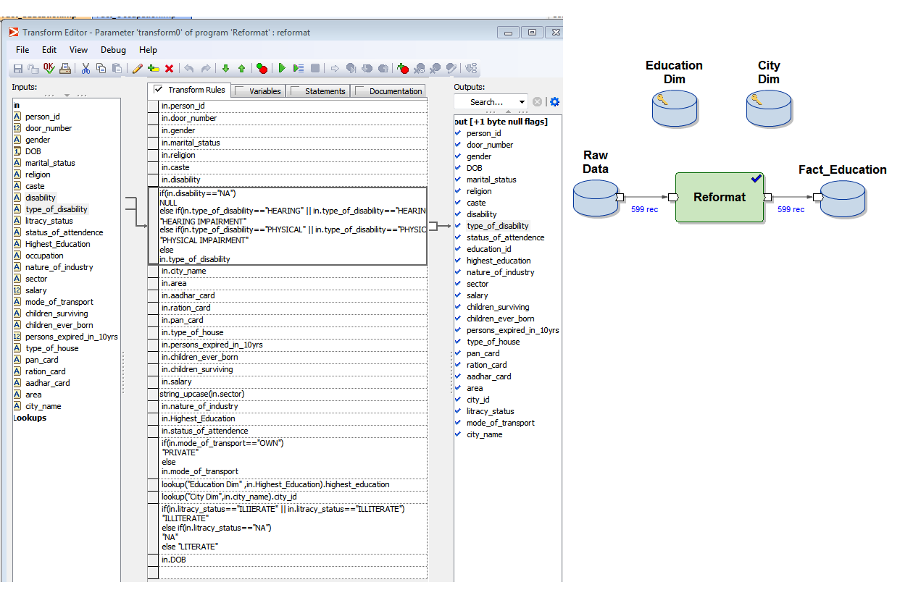
Generating Fact Table(EDUCATION)
Properties of Reformat and Joining by the help of LookUp.

Slide 8
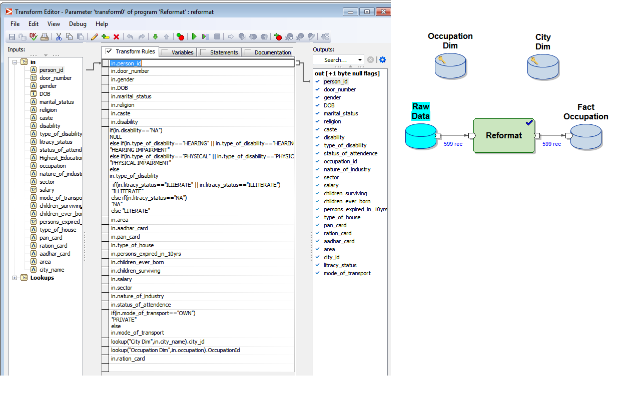
Generating Fact Table(Occupation)
Properties of Reformat and Joining by the help of LookUp.

Slide 9

SAMPLE REPORTS

Slide 10
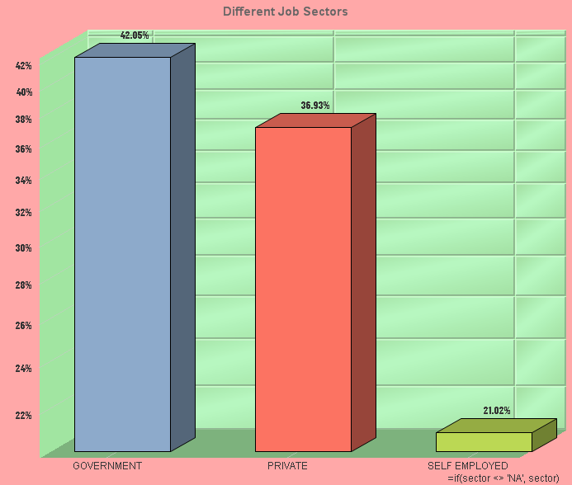
JOBWISE CLASSIFICATION
People Working In Different Sectors i.e. Government, Private and Self Employed

Slide 11
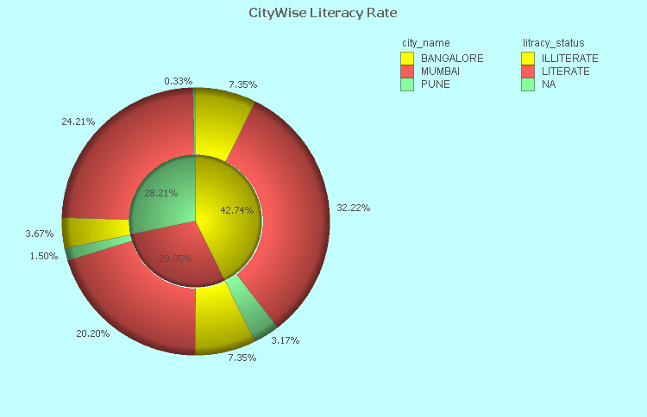
CITYWISE LITERACY RATE
Showing how many people are literate or illiterate in 3 Different Cities.

Slide 12


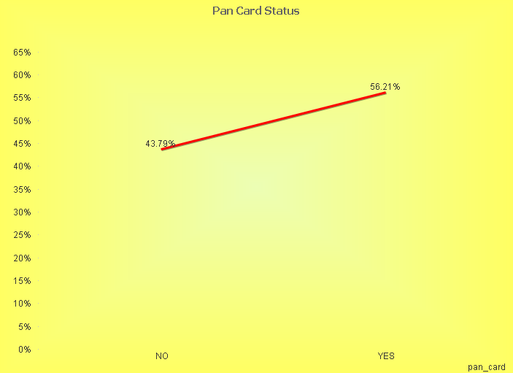
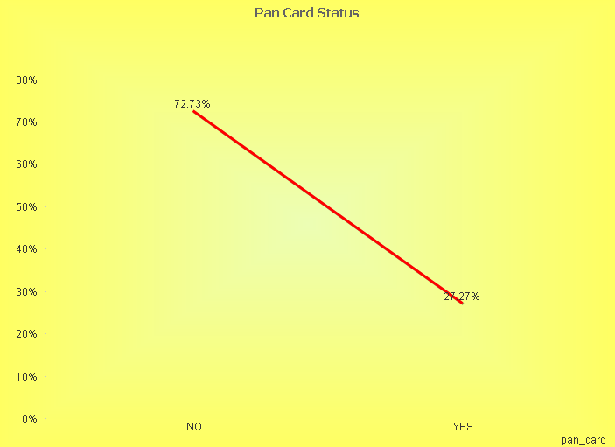
PANCARD Acc. To LITERACY STATUS

Slide 13
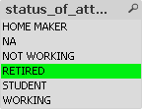
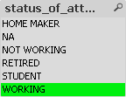
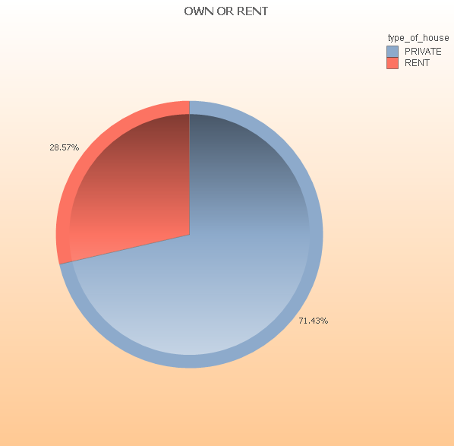
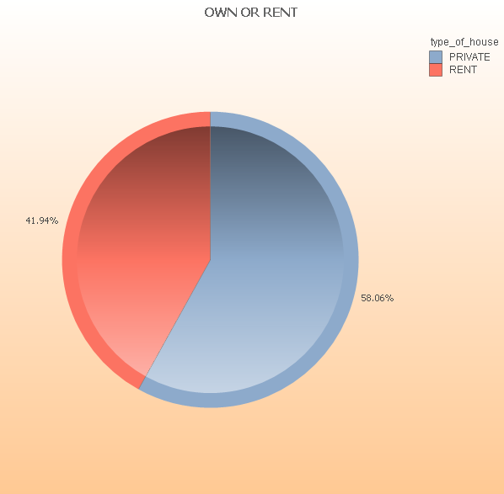
Type of House Acc. To Status Of Attendance.

Slide 14
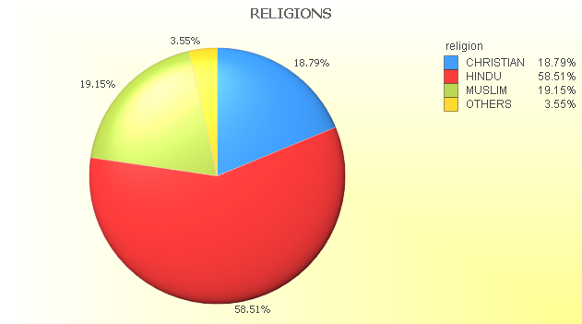
RELIGIONWISE CLASSIFICATION
Religion Wise
Classification in
Different Cities.

Slide 15
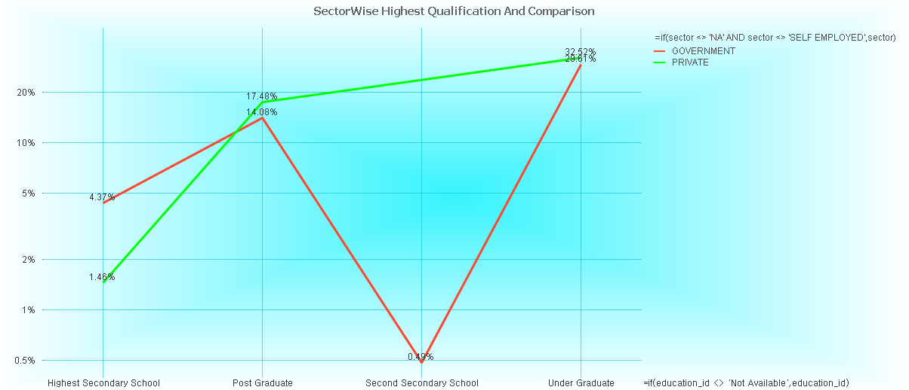
SECTORWISE HIGHEST QUALIFICATION COMARISON

Slide 16


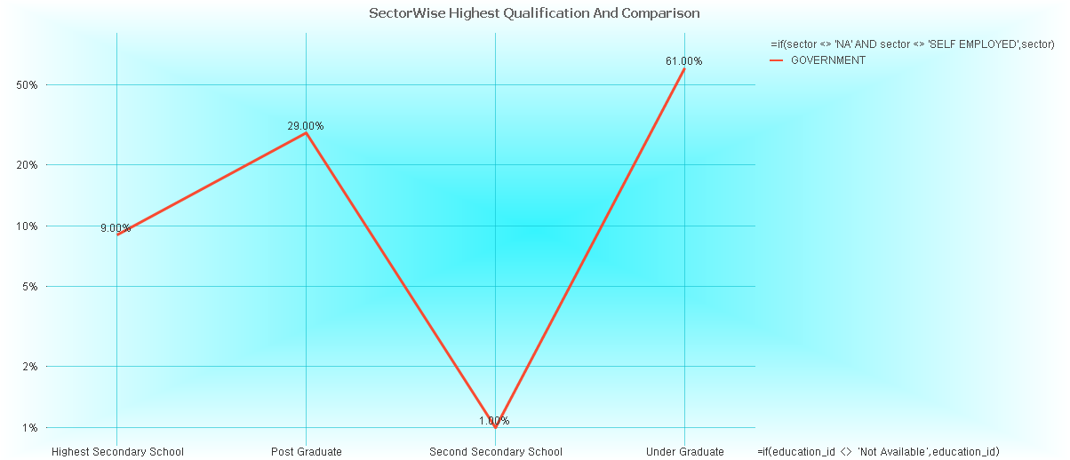
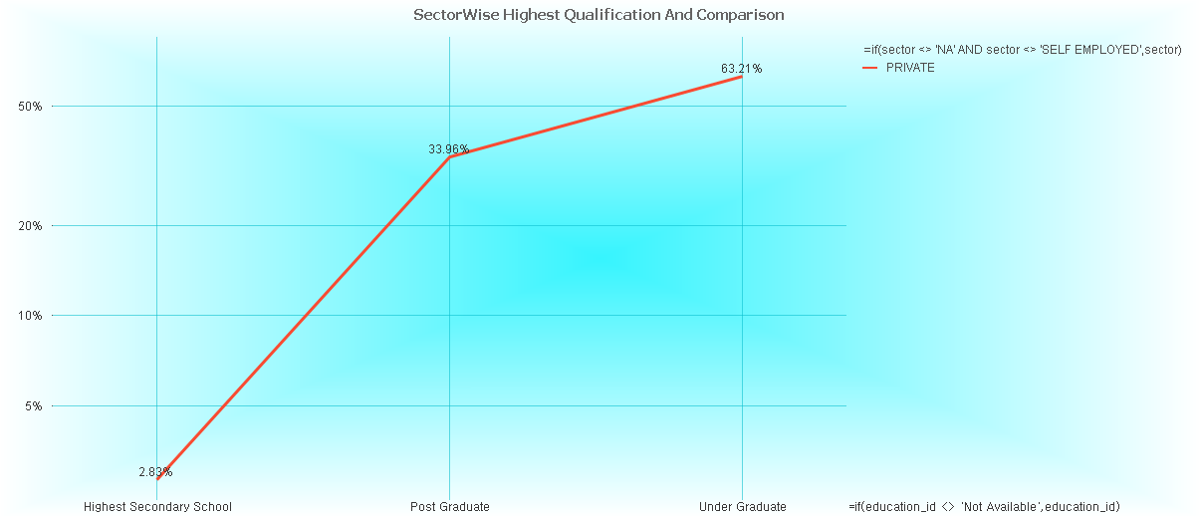
SECTORWISE HIGHEST QUALIFICATION

Slide 17
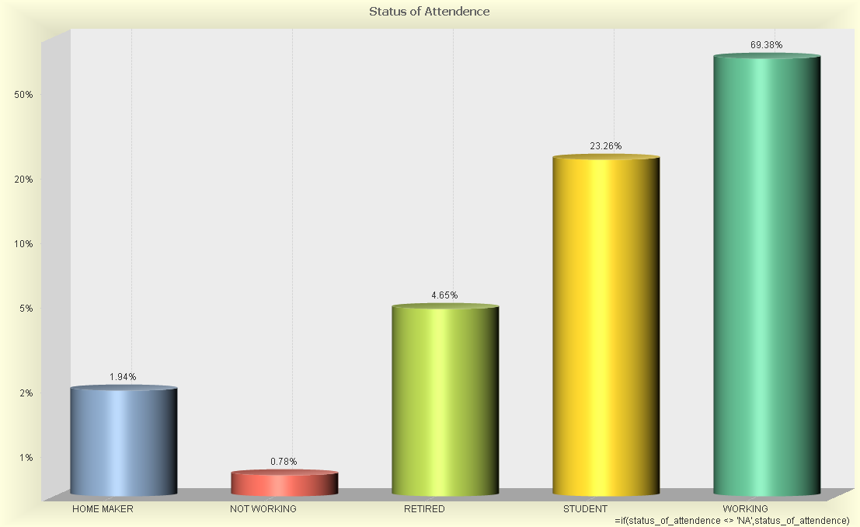
STATUS OF ATTENDENCE
Working Status
Of persons in
Different cities

Slide 18


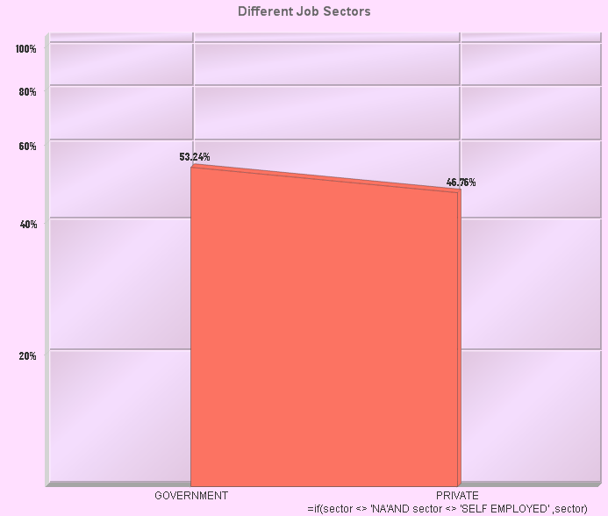
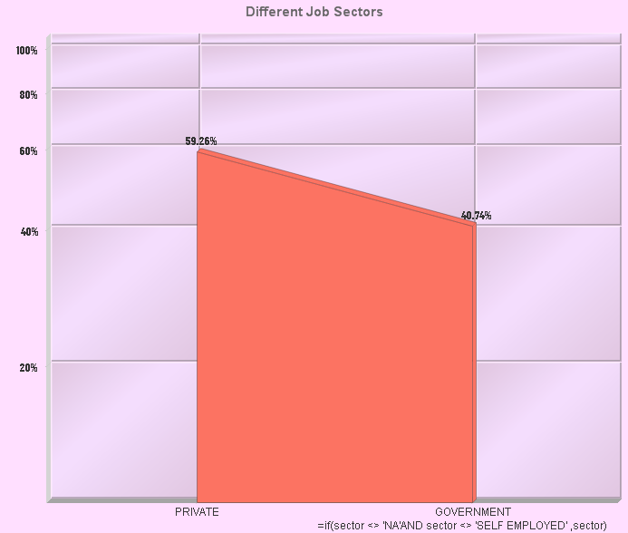
GENDERWISE JOB SECTOR

Slide 19
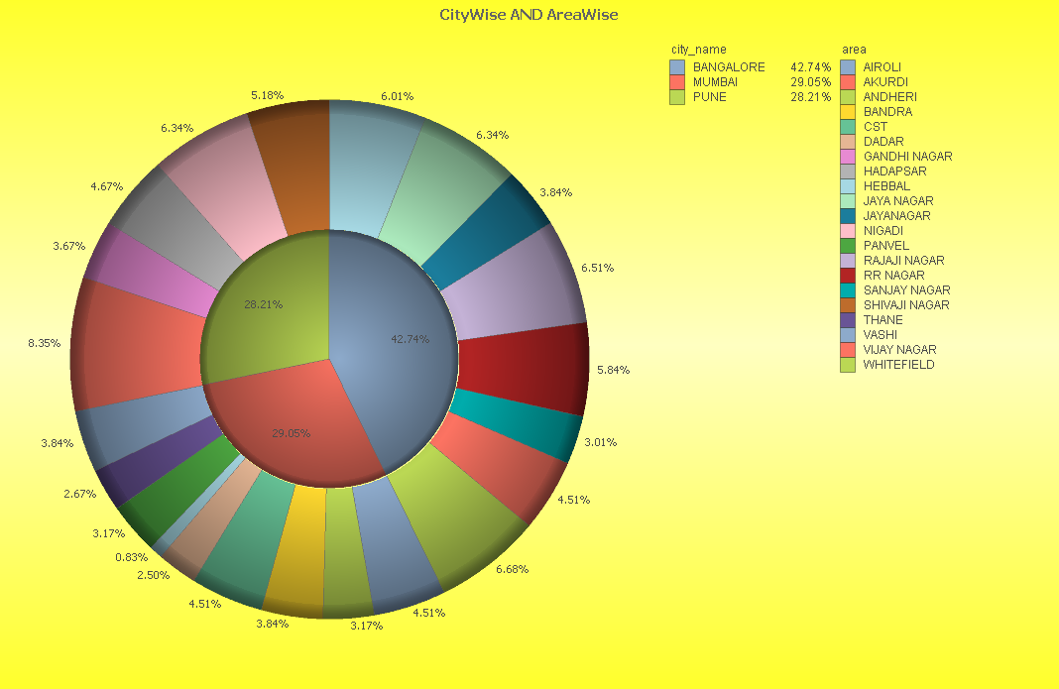
CITYWISE POPULATION DENSITY
Population in
Different city and
Area.

Slide 20
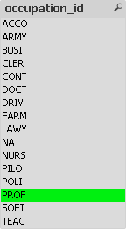
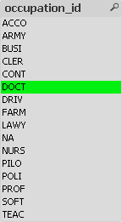
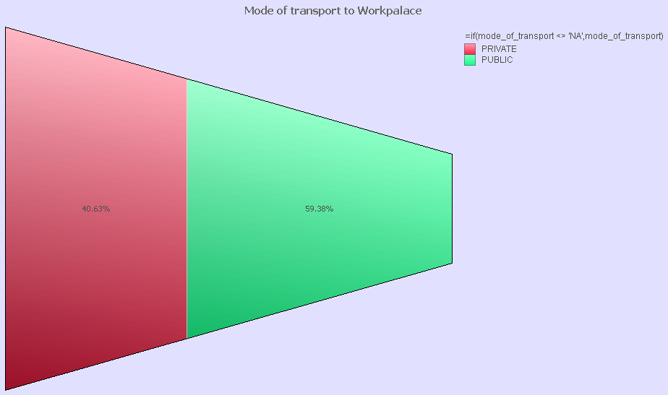
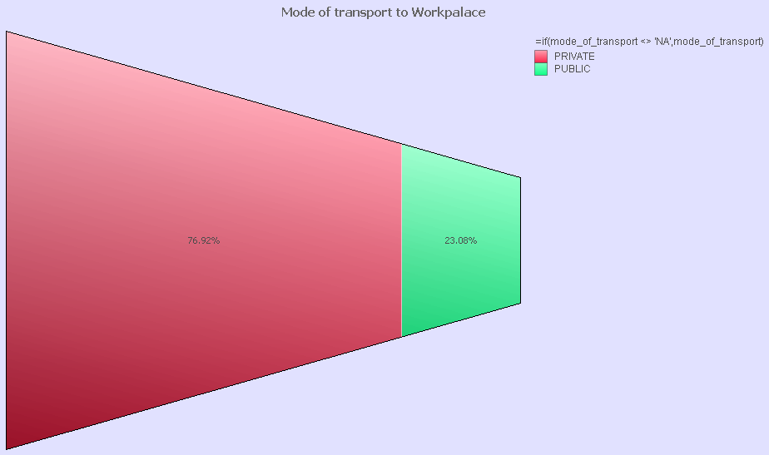
Mode of Transport To Workplace Acc. To Occupation

Slide 21
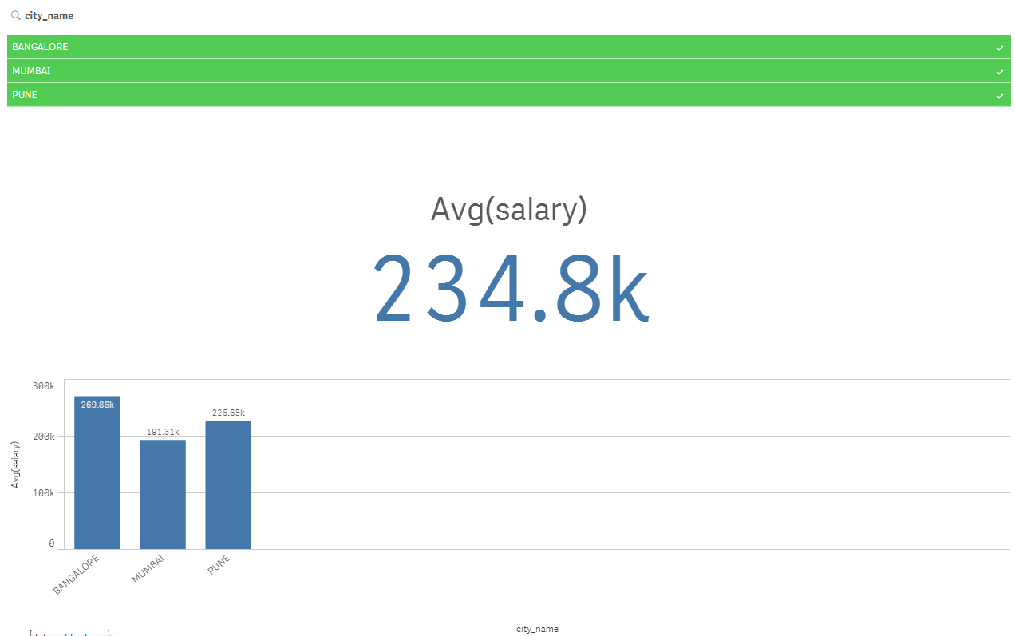
AVERAGE SALARY
Average salary of
3 Different Cities.
Avg. Salary of
Different cities-
Banglore-269.86k
Mumbai-191.31k
Pune-225.65k

Slide 22
THANK YOU!!

